Slide 1


Melting Pot of Origins:
Compromising the Intermediary Web Services that Rehost Websites
Takuya Watanabe, Eitaro Shioji, Mitsuaki Akiyama and Tatsuya Mori
NDSS Symposium, 24th February, 2020
Presented By:
Sivakanesan Dhanushkanda
PhD Student
Department of Computer Science
Old Dominion University, Norfolk, Virginia
@siva_skanda
Created as a course requirement for CS895 Web Archiving Forensics (by Dr. Michael L. Nelson), Fall 2022

Slide 2
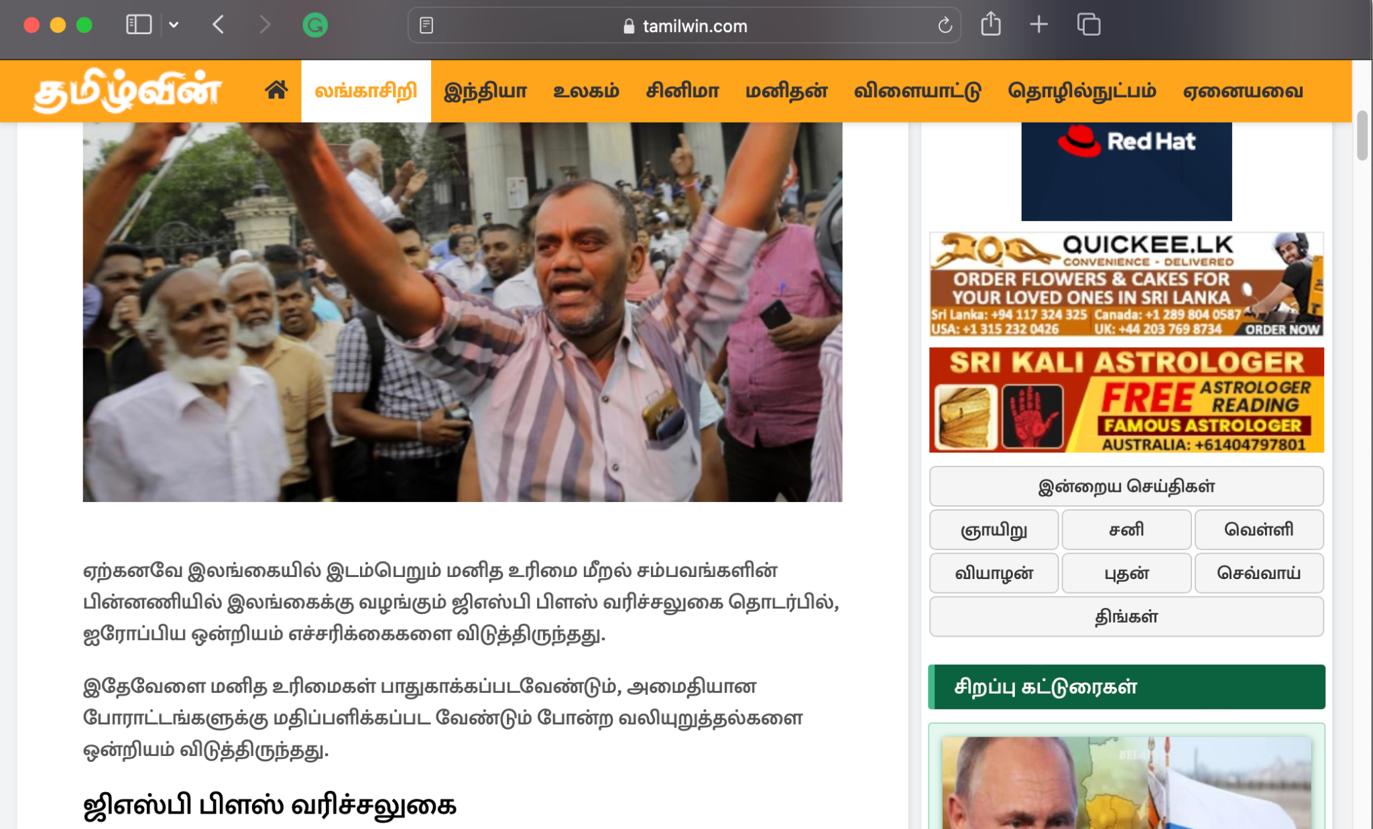
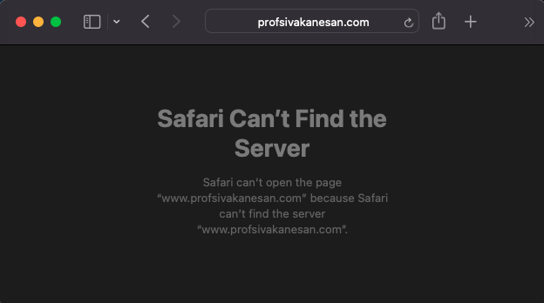
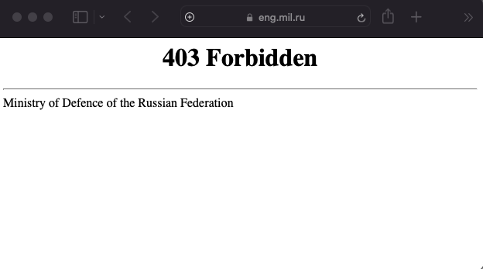
There Are Existing Barriers for Web Access
http://www.profsivakanesan.com/
https://tamilwin.com/article/european-union-commission-visit-to-sri-lanka-1664739614
https://www.sandboxx.us/blog/russian-military-websites-blocked-in-us-as-invasion-of-ukraine-commences/

Slide 3
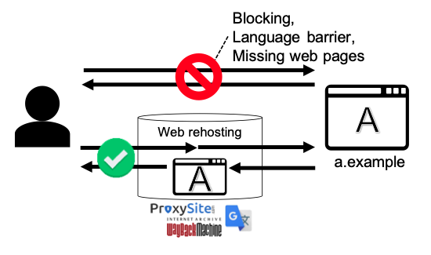
Rehosting Services Enable Users to Navigate
Beyond These Barriers
Fig 1, Watanabe et al. 2020

Slide 4


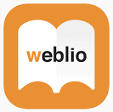











“Rehosting Services” Is the Umbrella Term for the
Three Separate Services
Website Translators
Web Archive
Web-based Proxy
21 Web Rehosting services were studied in the paper > 200 million accesses/day

Slide 5
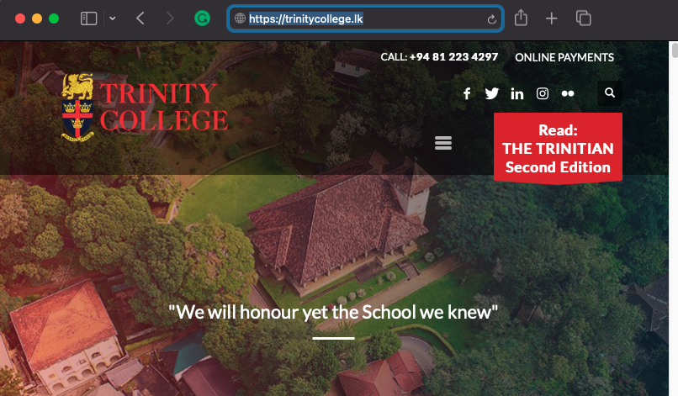
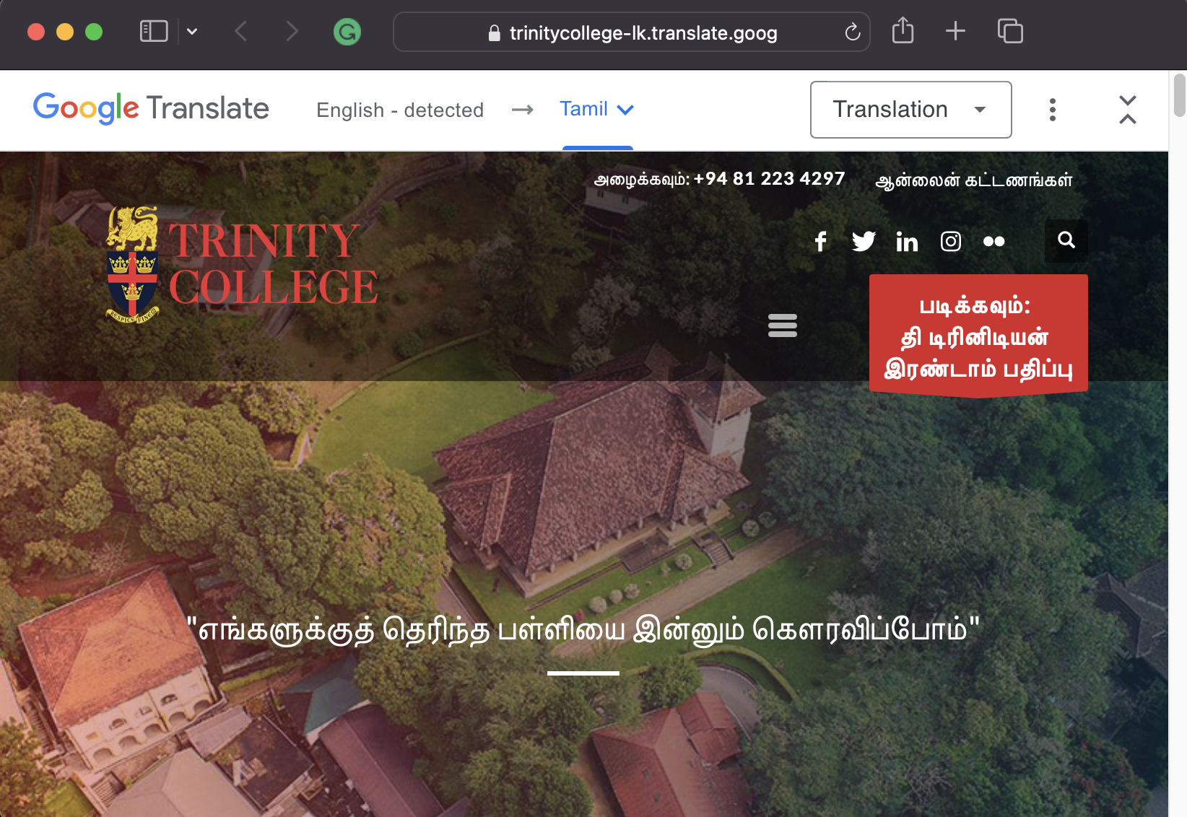
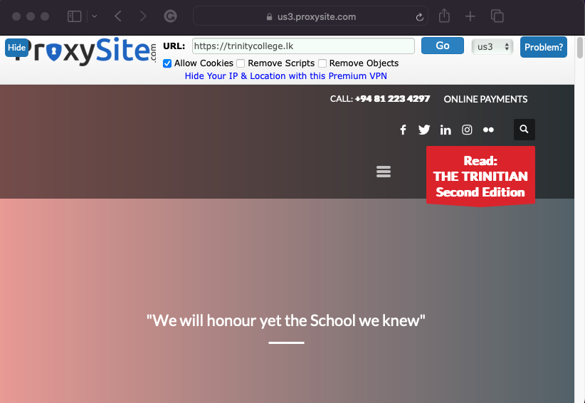
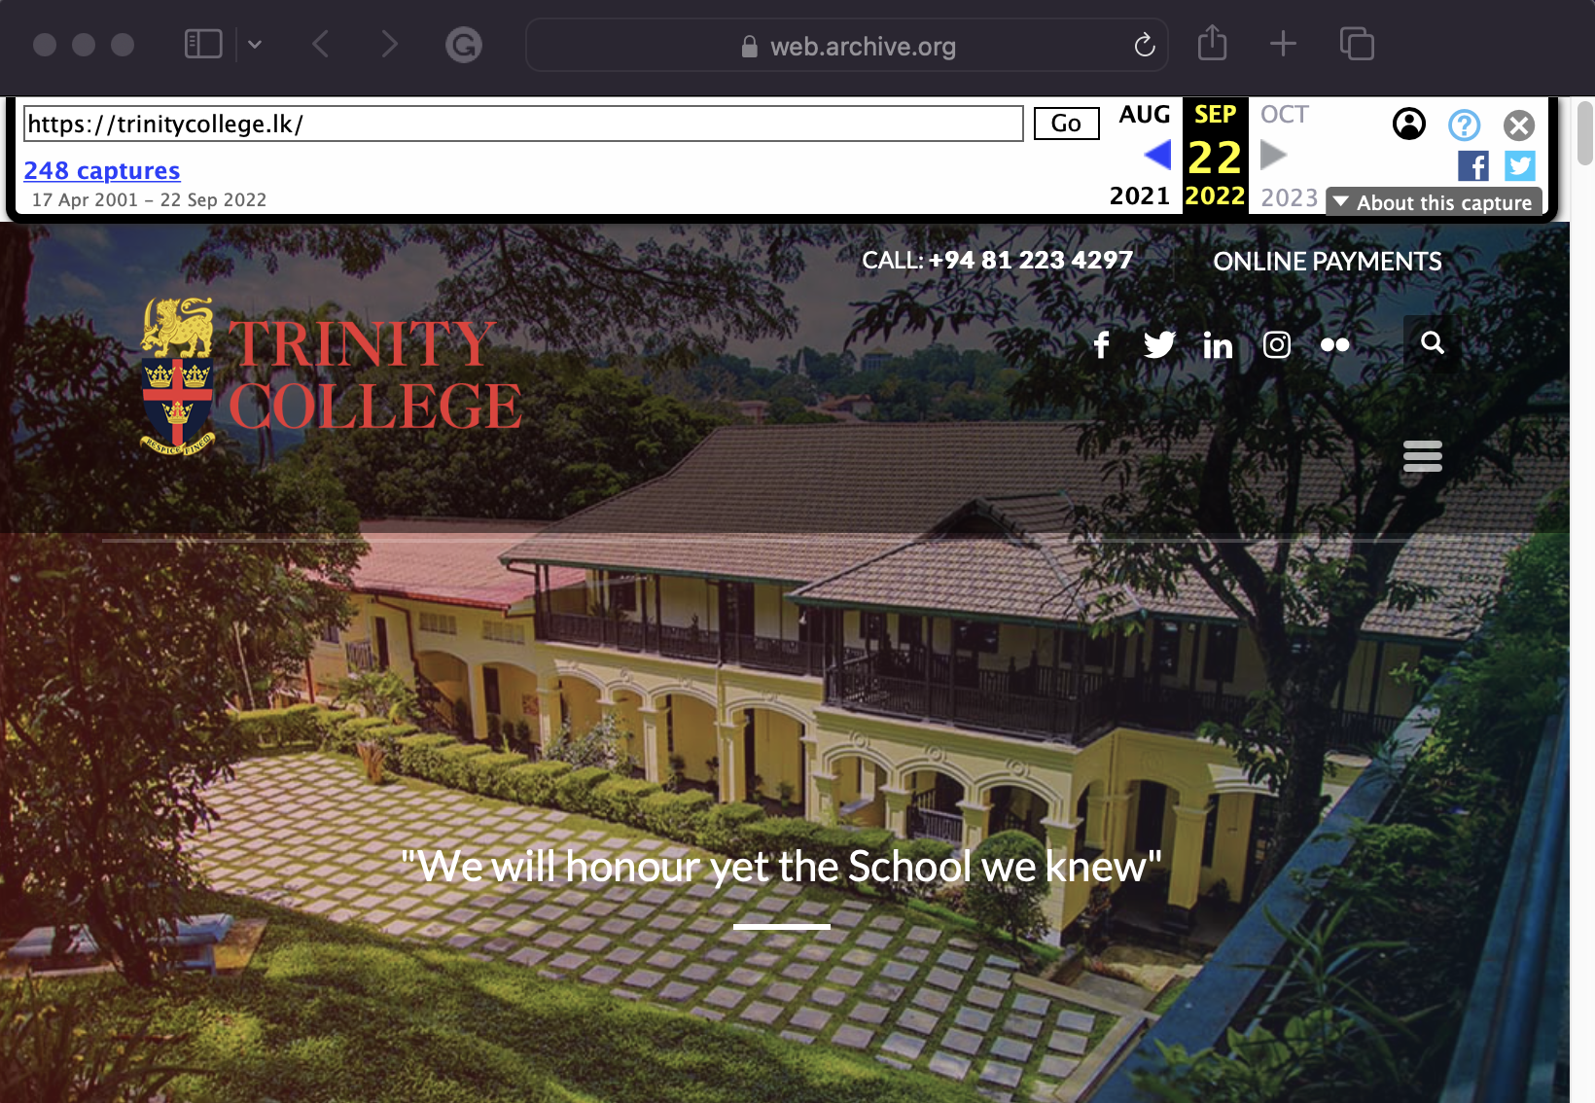
Rehosting My High School Website Homepage on proxysite.com
Direct URL
Web Translator (Google Translator)
https://trinitycollege.lk/
https://trinitycollege-lk.translate.goog/?_x_tr_sl=auto&_x_tr_tl=ta&_x_tr_hl=en&_x_tr_pto=wapp
Proxe Service (proxysite.com)
Web Archiving (Wayback Machine)
https://trinitycollege-lk.translate.goog/?_x_tr_sl=auto&_x_tr_tl=ta&_x_tr_hl=en&_x_tr_pto=wapp
https://web.archive.org/web/20220922114548/https://trinitycollege.lk/

Slide 6
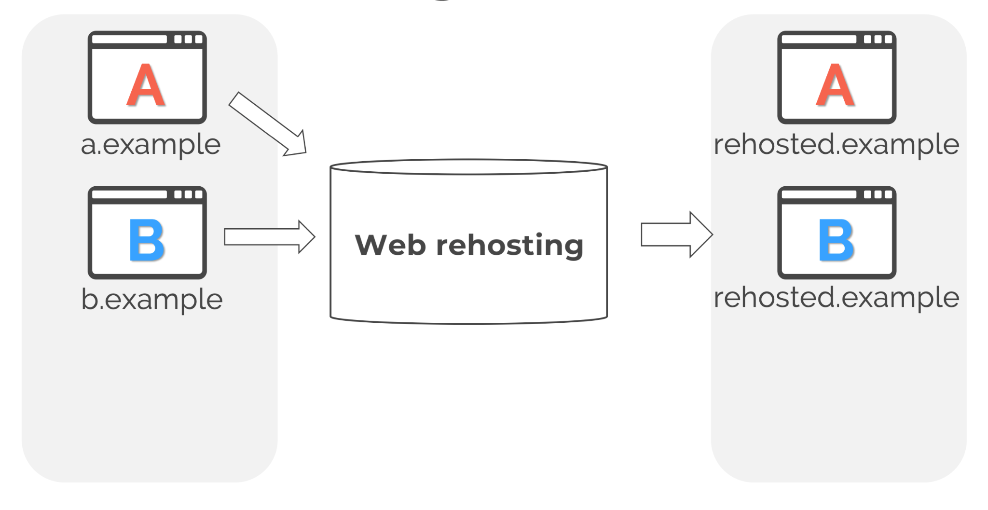
A Web Rehosting Service Acts As the Middleman
Watanabe, Melting Pot of Origins, Feb.2020, Slideshow
https://www.ndss-symposium.org/wp-content/uploads/24140-slides.pdf

Slide 7
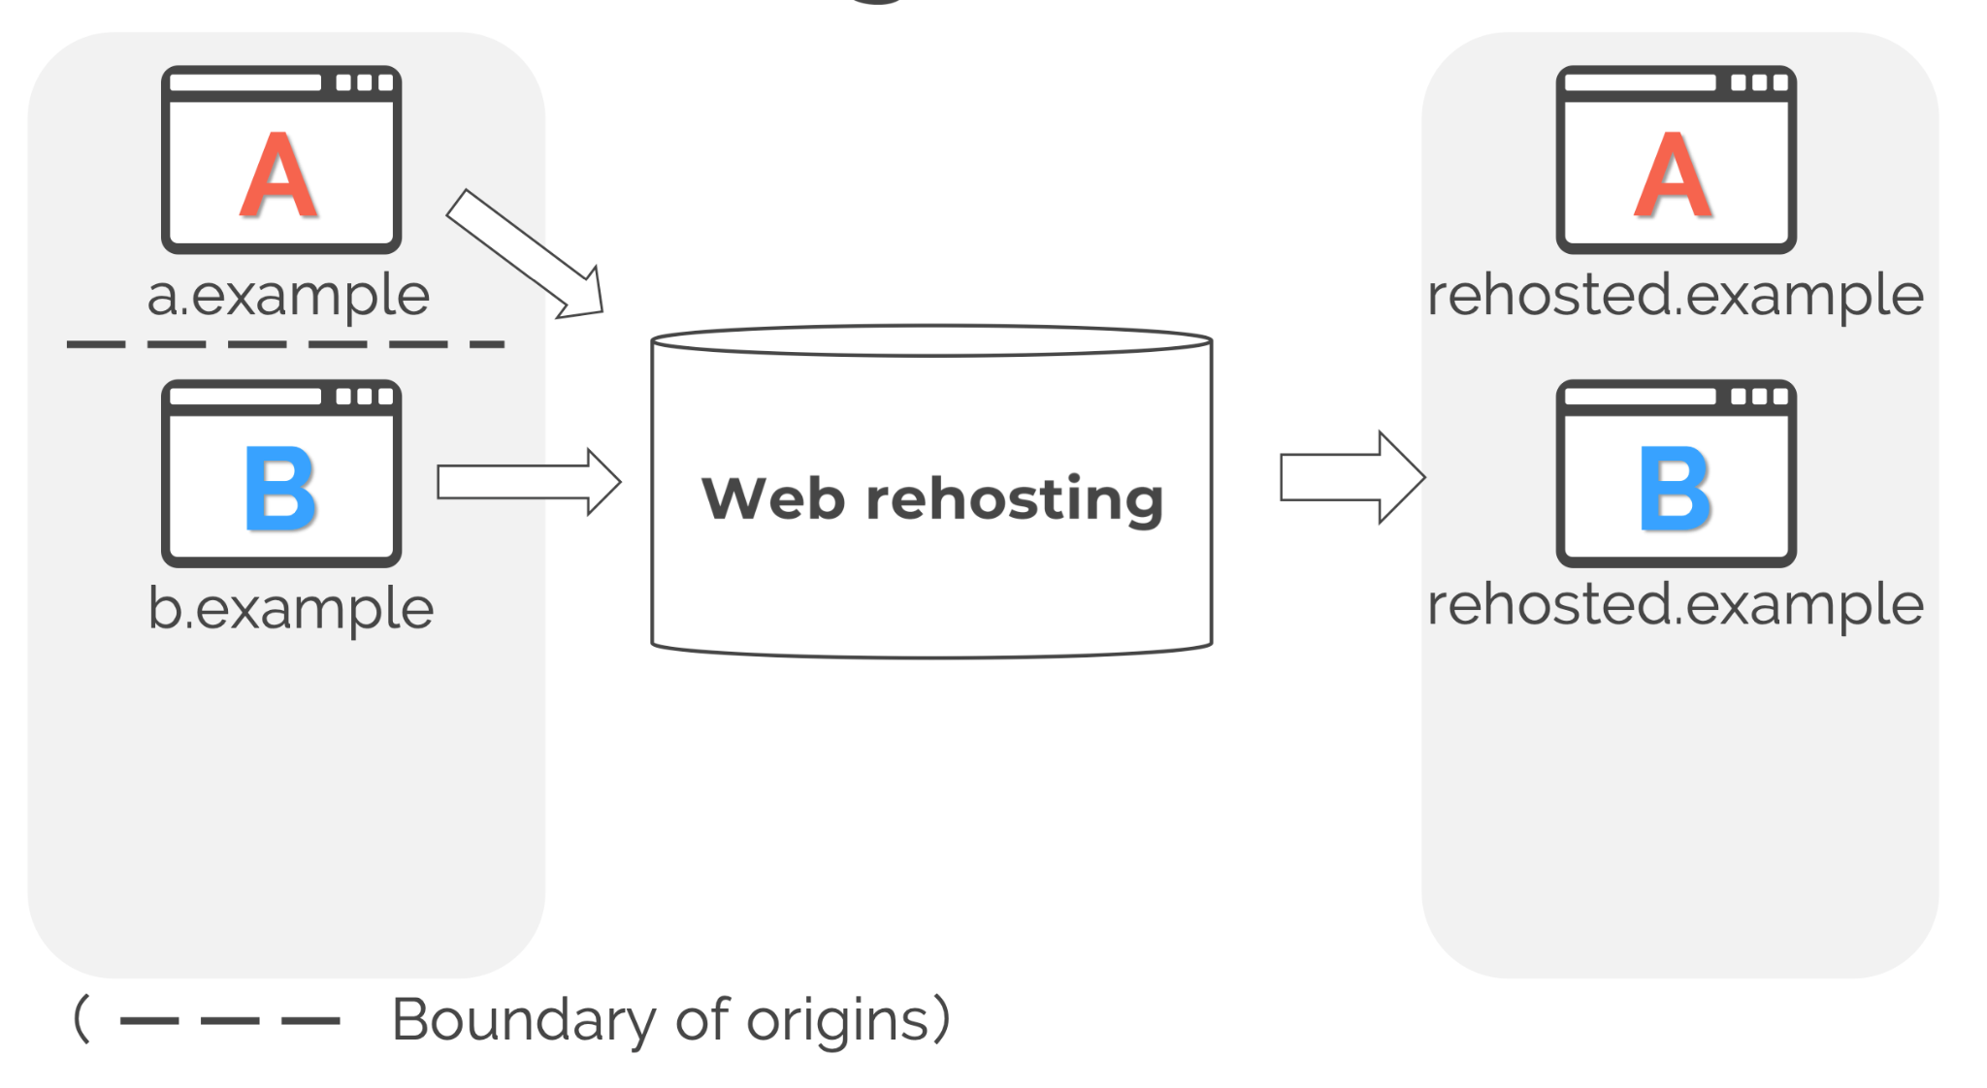
Rehosting Denotes a Single Origin, Hence the Term “Melting Pot of Origins”
Same Origin Policy (SOP)
Watanabe, Melting Pot of Origins, Feb.2020, Slideshow
https://www.ndss-symposium.org/wp-content/uploads/24140-slides.pdf

Slide 8
Same-Origin policy
Origin {protocol, host, port}
Two pages from different sources of origins should not be allowed to interfere with each other
Origin comparisons with http://store.company.com/dir/page.html:
Scheme/
Protocol
Hostname
URL | Outcome | Reason
http://store.company.com/dir2/other.html | Same origin | Only the path differs
http://store.company.com/dir/inner/another.html | Same origin | Only the path differs
https://store.company.com/page.html | Failure | Different protocol
http://store.company.com:81/dir/page.html | Failure | Different port (http:// is port 80 by default)
http://news.company.com/dir/page.html | Failure | Different host
Port
https://developer.mozilla.org/en-US/docs/Web/Security/Same-origin_policy

Slide 9
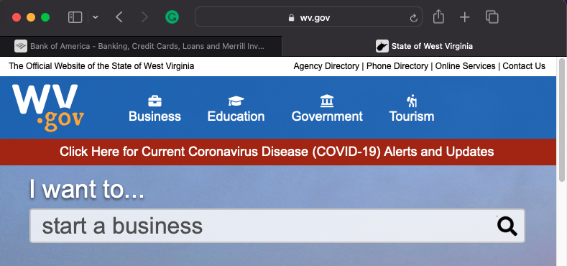
Same origins can talk with each other
Wv.gov should not interfere with other tabs
Bank of america account logged in

Slide 10
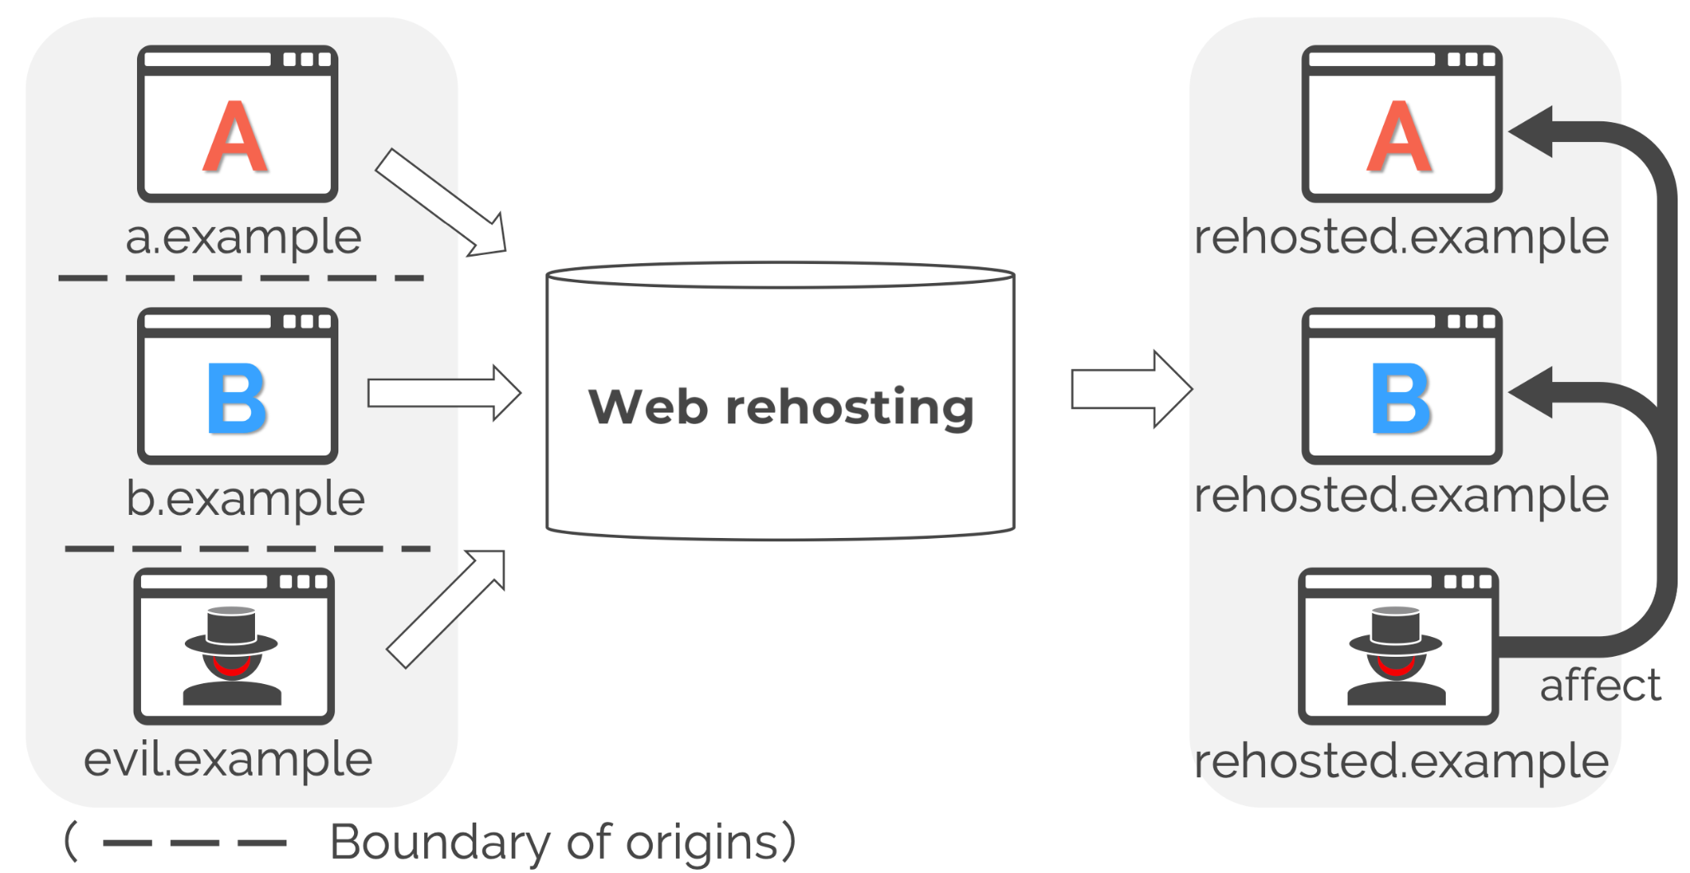
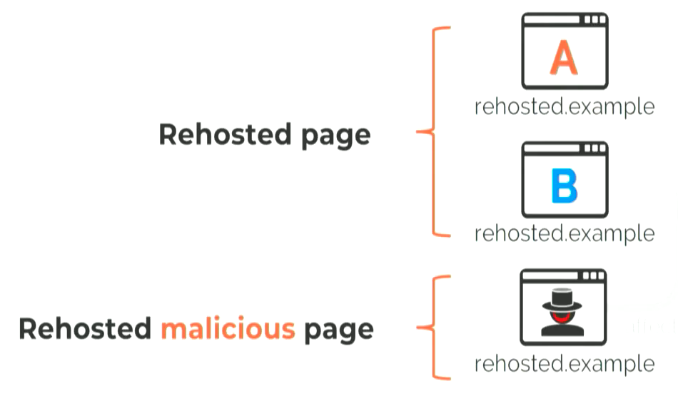
The Good and the Evil Have the Same Origin
After Being Rehosted
Figure 2, Watanabe et al. 2020

Slide 11

The Good and the Evil Have the Same Origin
After Being Rehosted
https://en.wikipedia.org/wiki/300_(film)
Figure 2, Watanabe et al. 2020

Slide 12
Web Rehosting Is Vulnerable to Many Attacks
# | Attacks | Exploited Resources
1 | Persistent MITM | Service Worker, AppCache
2 | Privilege Abuse | Camera, Microphone, Location, Notification, etc.
3 | Credential Theft | Password Manager
4 | History Theft | Cookie (written by JavaScript), localStorage
5 | Session Hijacking and Injection | Cookie (written by HTTP header)
Table 2, Watanabe et al. 2020

Slide 13
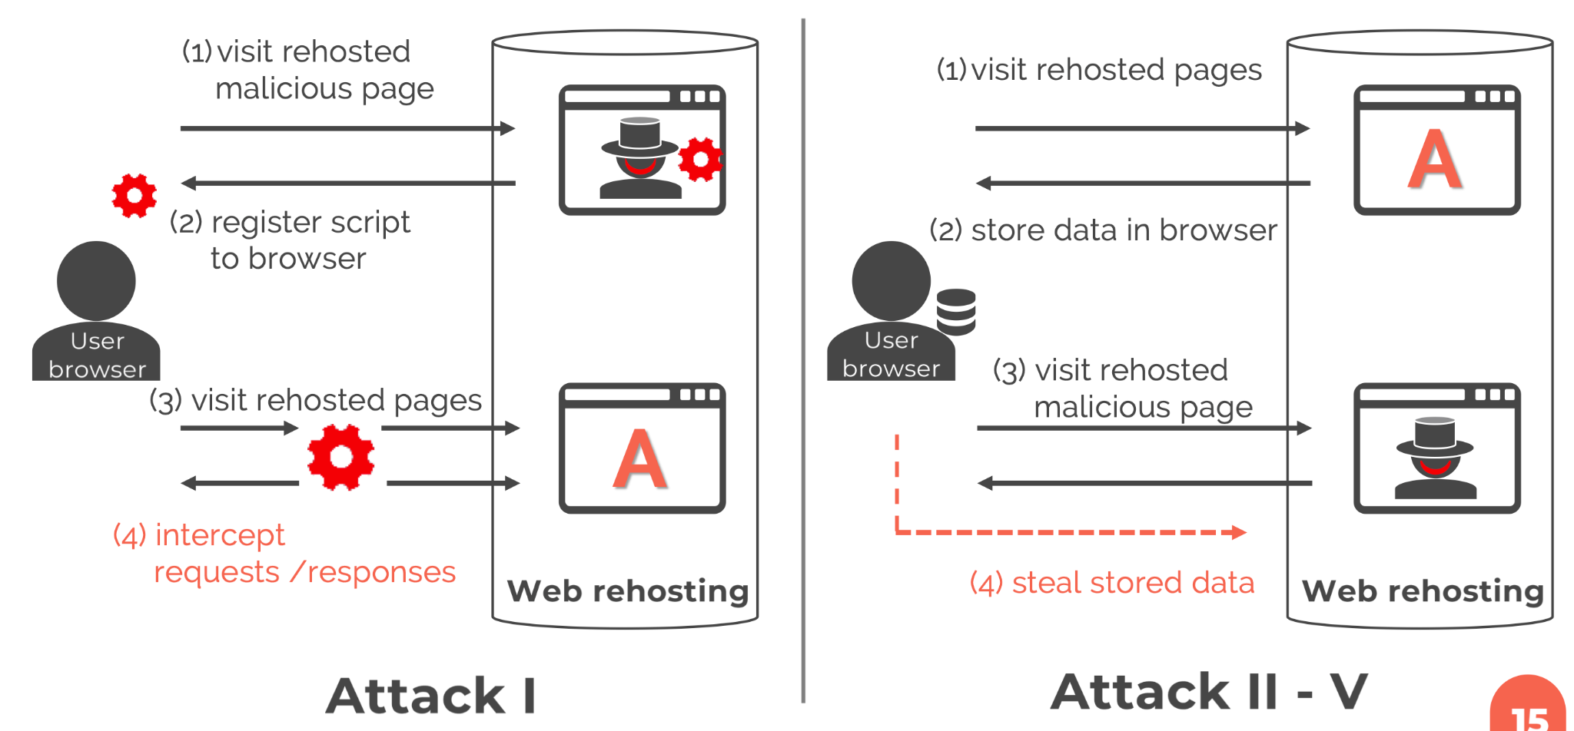
Threat Model: Two Main Attack Flow Types
Watanabe, Melting Pot of Origins, Feb.2020, Slideshow
https://www.ndss-symposium.org/wp-content/uploads/24140-slides.pdf

Slide 14
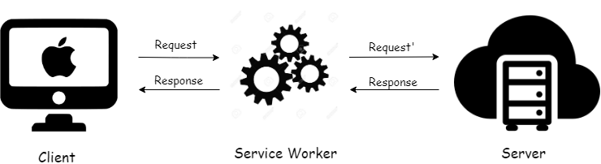
Service Worker (SW)
Powerful feature in HTML 5.1
Intercept all req/res
It can:
Modify the nuance of news articles
Replace movies
Inject ads
Display phishing page
Restrictions
HTTPS
Same Origin
SW script, register page, scoped pages
MIME Type (JavaScript)

Slide 15
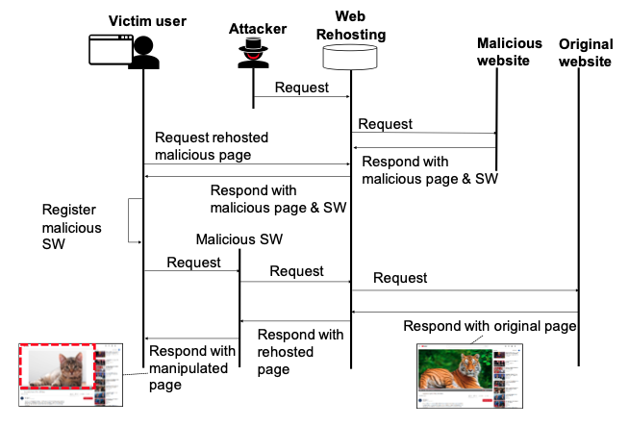
Service Workers (SW):
Proxy Requests and Responses Between Web Clients and Servers
Figure 3, Watanabe et al. 2020

Slide 16
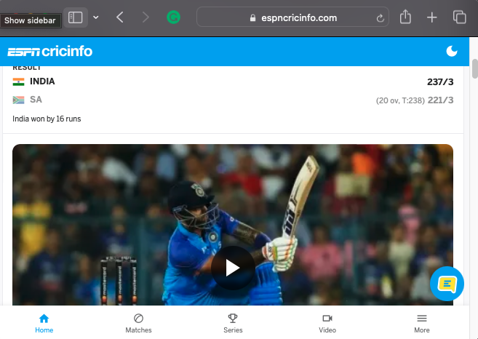
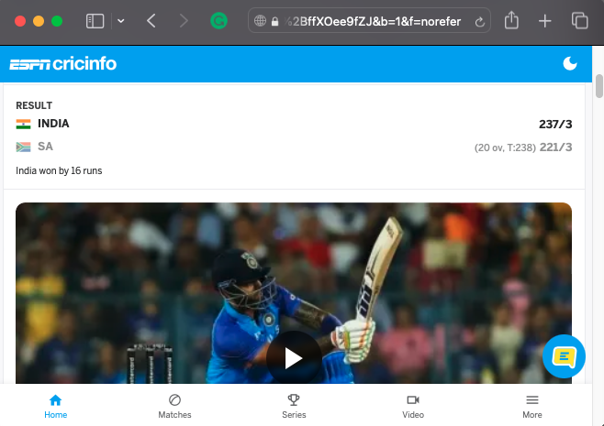

Attack 1: Persistent MITM
You are Hacked! Pay 20 BTC or Perish
Access ESPN Directly
Through a Proxy site
Through Proxy site, after attack

Slide 17
Attack 1: Persistent MITM
You are Hacked! Pay 20 BTC or Perish
Access ESPN Directly
Through a Proxy site
Through Proxy site, after attack
13 out of 21 web rehosting services are vulnerable!

Slide 18
Threat Model: Two Main Attack Flow Types
Watanabe, Melting Pot of Origins, Feb.2020, Slideshow
https://www.ndss-symposium.org/wp-content/uploads/24140-slides.pdf

Slide 19
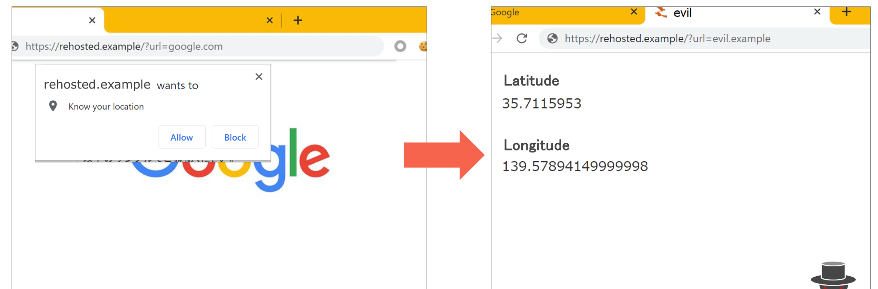

Attack 2: Privilege Abuse
User grants permission at rehosted page
Permission reused by the rehosted malicious page

Slide 20
Attack 2: Privilege Abuse
User grants permission at rehosted page
Permission reused by the rehosted malicious page
13 out of 21 web rehosting services are vulnerable!

Slide 21
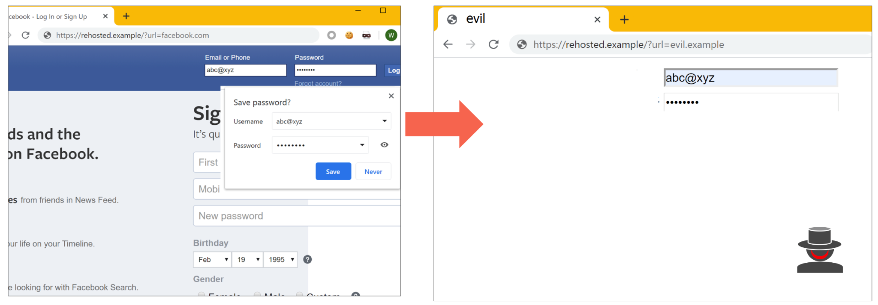
Attack 3: Credential Theft (for Web-based Proxy)
User logs into the rehosted page, saves credentials in password manager
Password manager auto-fills credentials on fake form of rehosted malicious page

Slide 22
Attack 3: Credential Theft (for Web-based Proxy)
User logs into the rehosted page, saves credentials in password manager
Password manager auto-fills credentials on fake form of rehosted malicious page
9 out of 11 web proxies services are vulnerable!

Slide 23
Attack 4: History Theft
User visits rehosted page.
Page writes cookie or localStorage by using JavaScript. document.cookie = “name=value” localStorage.setItem(‘name', value')
Rehosted malicious page retrieves cookie/localStorage.
Attacker estimates browsing history by using retrieved data.

Slide 24
Attack 4: History Theft
User visits rehosted page.
Page writes cookie or localStorage by using JavaScript. document.cookie = “name=value” localStorage.setItem(‘name', value')
Rehosted malicious page retrieves cookie/localStorage.
Attacker estimates browsing history by using retrieved data.
18 out of 21 web rehosting services are vulnerable!

Slide 25
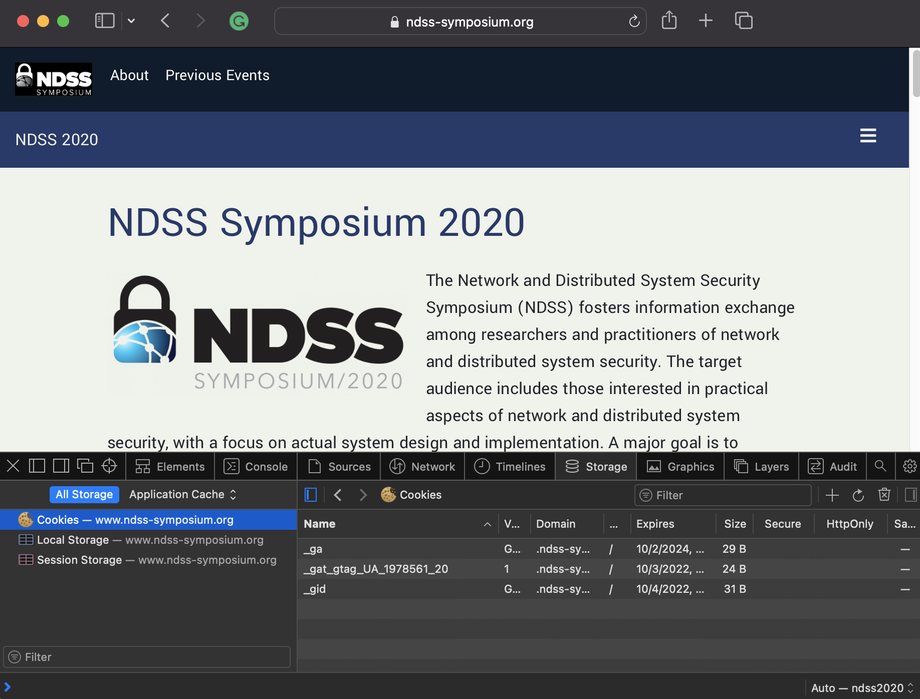
Non identifiable website
(has only general cookie names /localStorage keys)
Identifiable websites (has unique cookie name /localStorage keys
39.1% of Alexa top 10k
(2541 out of accessible 6500)

Slide 26
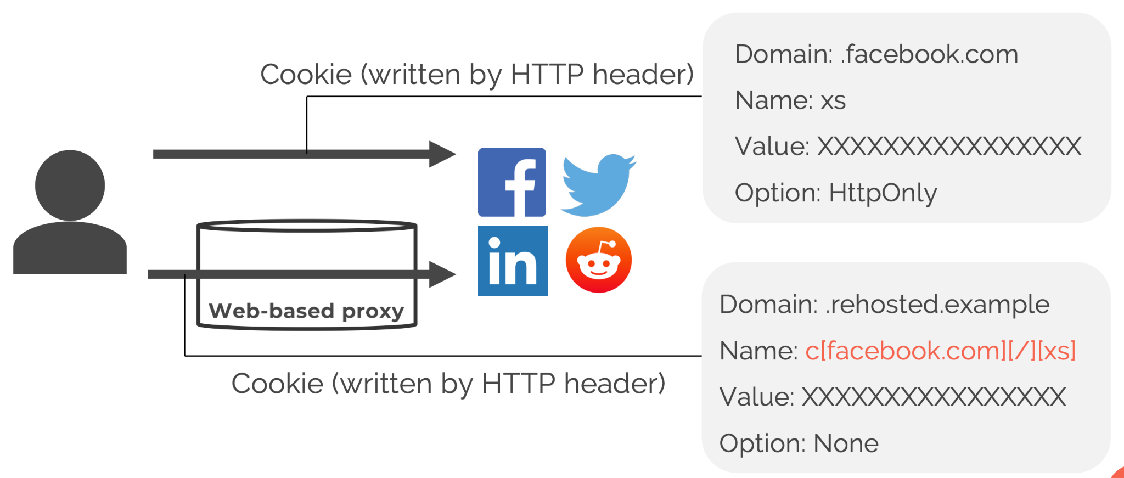

Attack 5: Session Hijacking & Injection
(for Web-based Proxy)
Watanabe, Melting Pot of Origins, Feb.2020, Slideshow
https://www.ndss-symposium.org/wp-content/uploads/24140-slides.pdf

Slide 27
Attack 5: Session Hijacking & Injection
(for Web-based Proxy)
8 out of 11 web proxies services are vulnerable!

Slide 28
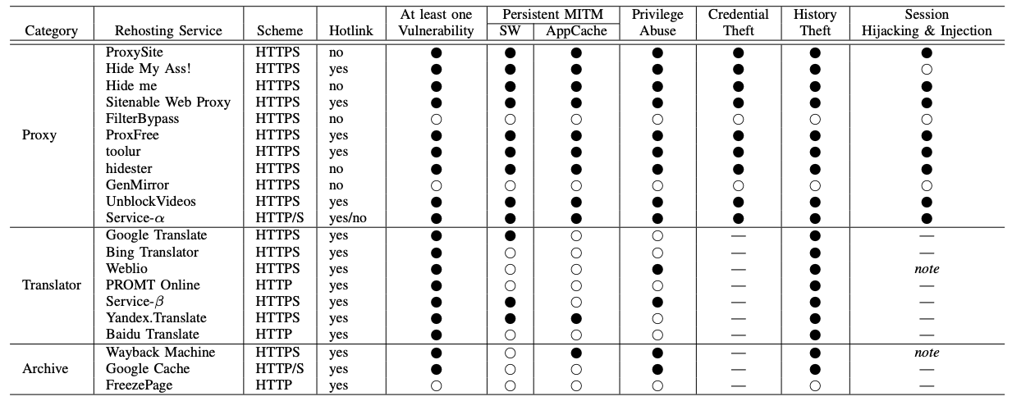
18 Out of 21 Rehosting Services Have At Least One Vulnerability
Table 4, Watanabe et al. 2020

Slide 29
Removing JavaScript Is the Best Protection
Table 4, Watanabe et al. 2020

Slide 30








Google Chrome Is Vulnerable in Every Way
# | Attacks | Browser
1 | Persistent MITM
2 | Privilege Abuse
3 | Credential Theft
4 | History Theft
5 | Session Hijacking and Injection

Slide 31
Measures for Attack-Resistant Web Rehosting
Separate domain names for each rehosted page
Already generated URLs become invalid
https://rehosted.example/?url=a.example
→ https://a-example.rehosted.example/
https://www-odu-edu.translate.goog/?_x_tr_sl=auto&_x_tr_tl=ta&_x_tr_hl=en&_x_tr_pto=wapp
https://www-nfl-com.translate.goog/?_x_tr_sl=auto&_x_tr_tl=ta&_x_tr_hl=en&_x_tr_pto=wapp
Disable SW and AppCache (attack 1)
Use HTTPOnly (attack 5)
Browser private mode
Firefox, Edge disable SW

Slide 32
Key Takeaways
Web rehosting services use a single origin to unify many different origins.
Violates SOP
Browser resources are exploited.
Service Workers, AppCache, browser permissions, password manager, localStorage, cookies
21 Rehosting services and 5 different attacks.
18 out of 21 are vulnerable to at least one attack
Rehosting providers were notified and countermeasures deployed
Future directions
Other rehosting services?
Service workers explored
WayBack machine and vulnerabilities explored

Slide 33
Summary of Results

Slide 34
Rehosting Rules
URL Rewriting
https://a.example → https://rehosted.example/?url=https://a.example
Rehostable File Type
HTML, plaintext
JavaScript (except some translators)
Handling Browser Resources
Remain resource accesses via JavaScript
Relay HTTP cookie (web proxy)

Slide 35
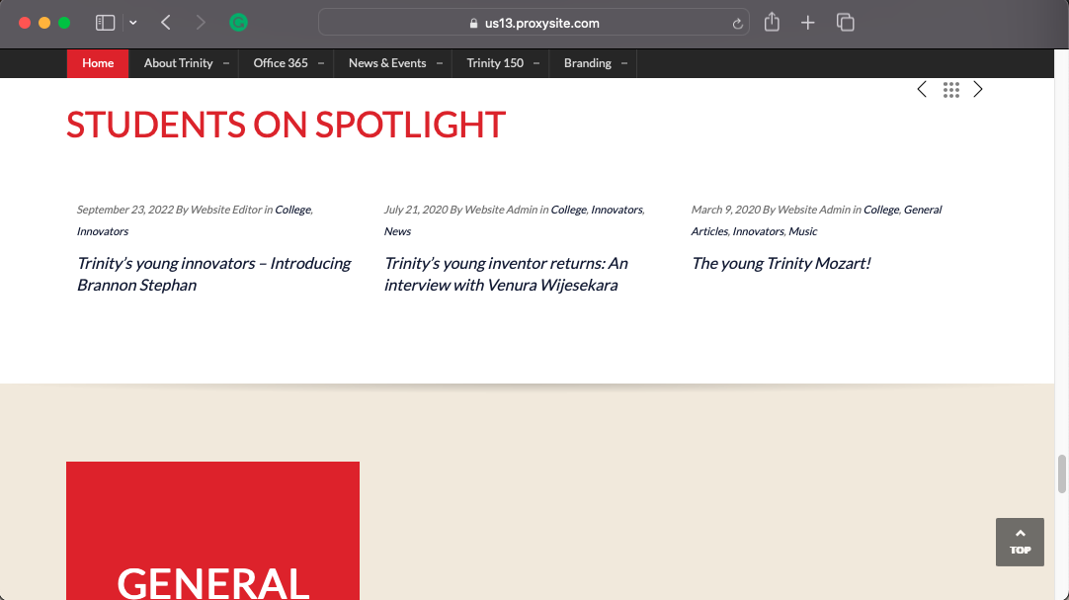
Rehosting My High School Website Homepage on proxysite.com
https://www.proxysite.com/
Rehosted URL
Direct URL
https://us14.proxysite.com/process.php?d=tzkJymJhV5eNrWHgOXBzVenUFOTb

